Slide 1
Proofs for Masking Schemes
Sebastian Faust
Ruhr University Bochum

Slide 2


Cryptodevices
cryptographic device
very secure
well-defined mathematical object
implementation
often proofs of security
much less secure!
many ways of implementing: details matter!
new attacks possible on crypto implementations
One reason: models of provable security do not capture many relevant implementation attacks

Slide 3
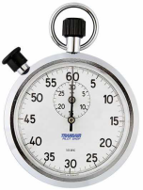
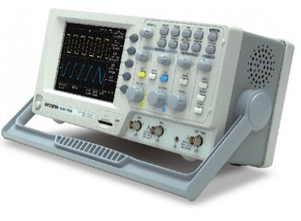

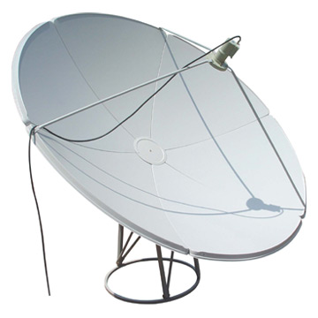
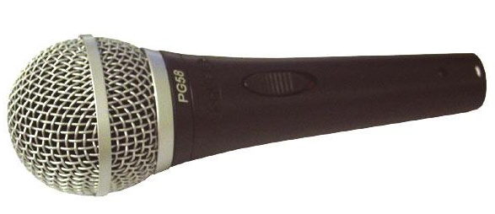
Theory vs. Reality
Black box model:
Attack Implementation:
KEY
implement
Controls inputs /outputs but internals stay hidden
Devices leak about internals
Best attack for AES practically impossible
Can break AES within days with side-channel analysis

Slide 4


Proofs for implementations
Include leakage into black-box model
Devise new schemes and prove their security
a) Specific schemes
b) Arbitrary computation
Many examples: encryption, signatures, authentication
Leakage resilient circuits
Why leakage resilient circuits?
1. Theoretical feasability: computation under leakage
2. Practically relevant: masking countermeasure

Slide 5
Leakage resilient circuits

Slide 6
Leakage resilient circuits
Masking

Slide 7




Important countermeasure
Masking: Protect all intermediate values of computation with randomized encoding Enc
K
K’
C
C’
Description of algorithm, e.g., AES
Computes AES on encoded values
Harder to exploit leakage from protected algorithm
Two ingredients of a masking scheme
Robust encoding function
K
Enc(K)
Leaks less about k

Slide 8
Important countermeasure
Masking: Protect all intermediate values of computation with randomized encoding Enc
K
K’
C
C’
Description of algorithm, e.g., AES
Computes AES on encoded values
Harder to exploit leakage from protected algorithm
Two ingredients of a masking scheme
Robust encoding function
Operations computing with encoded values
Enc(X)
Compute on encoded values
Enc(X*Y)
Enc(Y)

Slide 9
Leakage resilient circuits
Circuit Compiler

Slide 10
Leakage resilient circuits
Formalization of masking by Ishai-Sahai-Wagner-03
K
C
X
Y
Arbitrary computation modeled as a circuit

Slide 11

Leakage resilient circuits
Formalization of masking by Ishai-Sahai-Wagner-03
?
K
Circuit compiler
K’
C
C’
Y
X
Y
X
Circuit Compiler: Run once at production time (no leakage)
Input: Description of circuit C with key K (e.g., circuit for AES)
Output: Description of circuit C’ with key K’ (C’ is probabilistic)
Correctness: C[K] and C’[K’] have same functionality
Additionally: C’[K’] leakage resilient for many executions
➔ adversary learns nothing “useful” from leakage
How to formalize this?

Slide 12
Simulation-based security
Adversary learns no more than by black-box access
K
K’
C’
C
Real:
Ideal:
What function can the leakage f be?
Repeat many times
X,
f
X
Y
Y, f(state)
indistinguishable
output
output
Continuous leakage: many observations are possible
What does it mean?
For unbounded adversary: MI(K ; f(.), ... f(.)) < negl
Even more: Cannot break underlying security notion
Notes:
Write state in leakage function

Slide 13
Leakage resilient circuits
t-probing model

Slide 14

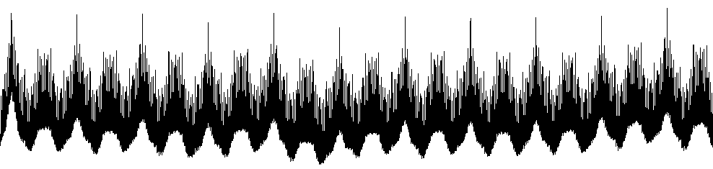
n-Probing adversary (ISW03)
Adversary gets t intermediate values of computation
➔ L = { values on t adversarial chosen wires }
●
+
C
●
M
t-probing attack formalization of t-variate attacks
…
Learns nothing if t < n
Basic ingredient: Additive masking
K
Encode
K := (K₁…K_{n}) s.t. K=K₁+...+ K_{n}
How to compute with additive encodings?

Slide 15
ISW Compiler: High level
output
output
Dec
K’
D
and
K
C
C’
and
neg
C s.t. Dec(C)=a∧s
neg
and
and
C s.t.Dec(C)=s∧s’
and
s
s’
and
a
A
S
S’
Enc
1. Memory:
a
Encoded with additive masking, i.e., S = (S₁…S_{n}) such that
s = S₁ + … + S_{n}
A bit s
Notes:
Recall…

Slide 16
ISW Compiler: High level
output
output
Dec
K’
D
and
K
C
C’
and
neg
C s.t. Dec(C)=a∧s
neg
and
and
C s.t.Dec(C)=s∧s’
and
s
s’
and
a
A
S
S’
Enc
2. Wires:
a
Each wire
w = a ∧ b
Wire bundle carrying encoding C such that w = Dec(C)
Main challenge: computing on encoded inputs!

Slide 17
ISW Compiler: High level
output
output
Dec
and
D
and
neg
C s.t. Dec(C)=a∧s
neg
and
and
C s.t.Dec(C)=s∧s’
and
*
s
s’
and
a
A
S
S’
Enc
a
Gadgets built from standard gates operating on encodings
3. Gates:
Main challenge: algorithm to securely compute AND!

Slide 18
ISW Compiler: Results
Theorem: A compiler that makes any circuit resilient to adversary that probes up to n wires in C’
K’
K
C’
C
Blow-up in size: O(n²) for each AND gate in C
Leakage bounded per observation: t < n wires
Proofs in n-probing model: Systematic and simple tool to find n-th variate flaws in masking schemes
Barthe et al. EC15: Automated tool to verify proofs
Drawback: L only probing ➔ oblivious of many wires

Slide 19
Leakage resilient circuits
More powerful leakages

Slide 20



New model for circuits
Bounded independent leakages
Circuit C’
input
L
R
output
T
f(L,T)
g(R,T)
Processors can communicate with each other –
Think of it as a 2-party protocol!
Bounded leakage function:
Assumption: Processors leak independently!
m bits
f
- Arbitrary efficient functions
c bits
➔ Everything that is touched on a processor leaks!
- Ony restriction: input shrinking, i.e., c < m
Realistic? Includes many functions, e.g. weighted sums
Additive masking? Insecure: learn parities of L & R

Slide 21
Inner Product Masking
Sample L,R uniformly in {0,1}^{n} s.t. S= <L,R> = Σ L_{i}*R_{i} and store parts separately on two processors
n
n
?
L
R
f(L)
g(R)
Thm [DDV10]: if leakage is bounded in total to c bits then adversary learns nothing about S
High min-entropy and independent sources
L
Extract
̴̴̴ uniform
R

Slide 22
IP Compiler: High level
output
output
Dec
K’
(L,R)
and
K
C
C’
and
neg
(L,R) s.t. <L,R>=a∧S
neg
and
and
(L,R) s.t. <L,R>=S∧S’
and
S
S’
and
a
(L,R)
(L’,R’)
S
(L’’,R’’)
S’
Enc
a
1. Wires and state is encoded using IP masking
2. Gates are replaced by protocols working on IP masking
➔ Most difficult: protocol to compute AND

Slide 23
Outline: MULT operation…
Input: encoding (L,R) of S and (L’,R’) of S’
Output: securely compute encoding (L’’,R’’) of S*S’
S
L
L’
S’
R’
R
L’’
R’’
S’’
Notice: L,L’ and R,R’ each hold by one player

Slide 24
An observation
S
L
L’
S’
R’
R
A :=
=: B
L₁L'₁
L₁L'₂
L₁L'₃
R₁R'₁
R₁R'₂
R₁R'₃
R
L
*
* | L₁ | L₂ | L₃
L'₁ | L₁L'₁ | L₂L'₁ | L₃L'₁
L'₂ | L₁L'₂ | L₂L'₂ | L₃L'₂
L'₃ | L₁L'₃ | L₂L'₃ | L₃L'₃
R₁ | R₂ | R₃ | *
R₁R'₁ | R₂R'₁ | R₃R'₁ | R'₁
R₁R'₂ | R₂R'₂ | R₃R'₂ | R'₂
R₁R'₃ | R₂R'₃ | R₃R'₃ | R'₃
L₂L'₁
L₂L'₂
L₂L'₃
R₂R'₁
R₂R'₂
R₂R'₃
*
L’
R’
L₃L'₁
L₃L'₂
L₃L'₃
R₃R'₁
R₃R'₂
R₃R'₃
*
Easy calculation:
<A,B> = <L,R> * <L’,R’> = S*S’

Slide 25


Outline: MULT operation…
L
L’
R’
R
Computes locally:
Computes locally:
 | L₁ | L₂ | L₃
L'₁ | L₁L'₁ | L₂L'₁ | L₃L'₁
L'₂ | L₁L'₂ | L₂L'₂ | L₃L'₂
L'₃ | L₁L'₃ | L₂L'₃ | L₃L'₃
R₁ | R₂ | R₃
R₁R'₁ | R₂R'₁ | R₃R'₁ | R'₁
R₁R'₂ | R₂R'₂ | R₃R'₂ | R'₂
R₁R'₃ | R₂R'₃ | R₃R'₃ | R'₃
A
B
protocol
L’’
R’’
<A,B> = S * S’
the length of A and B is quadratic in n!
Provably secure protocol in [DF12]

Slide 26
The IP masking compiler
Theorem:
A new information theoretic secure compiler with security against continuous independent leakage
K’
K
C’
C
x
Blow-up in size: O(n²) for each AND gate in C
Leakage bounded per exec.: c bits from each processor
IP masking in practice?

Slide 27
Leakage resilient circuits
IP masking in practice

Slide 28
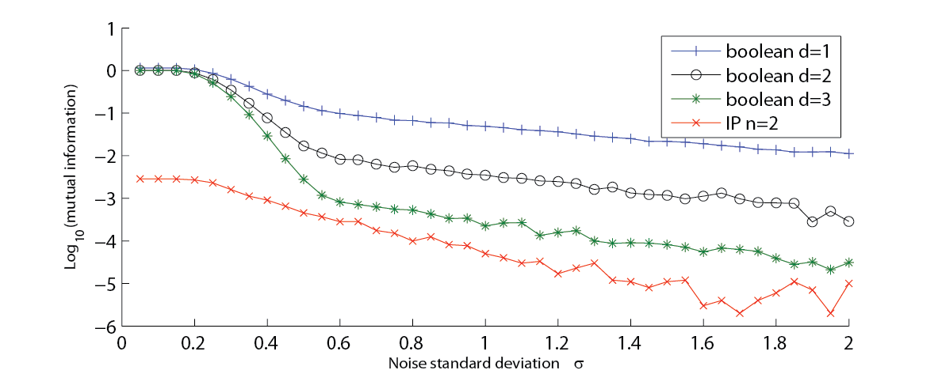
IP Masking in practice? (BFGV12, BFG15)
Green curve: Boolean masking with 3 random shares in GF(2⁸)
Analyzed for small security parameter n –
Security outperforms Boolean masking
Red curve: IP masking with 3 random shares in GF(2⁸)
Mutual information between HW leakage and secret
x
Weaker dependency between leakage & secret for IP masking
Main reason: Non-linear masking vs. linear masking
Performance: Runs AES in 300k clock cycles for n=2
Use squaring whenever possible ➔ it’s cheap!
Efficient implementations for add and multiplication

Slide 29
Leakage resilient circuits
Noisy leakages

Slide 30

Bounded leakage?
Beautiful theory! Q: Does it match practice?
Models do not match with my engineering experience
Leakages are not quantitatively bounded
Physical leakages are inherently noisy
Difficulty in many attacks: how to eliminate the noise?

Slide 31
Noisy leakages – Chari et al. 99
No quantitative bound on leakage, but leakage is noisy
b₁
b₂
…
...
b_{n}
For bit b: Enc(b)
Leakage is b_{i} + Gaussian noise
...
Chari et al. only consider security of a single masked bit
p-noisy functions N(.): More general noise distribution [PR13]
uniform
X₀, X₁
1. b⬅ {0,1}
2. N(X_{b})
N(X₀), X₀, X₁
≈
N(X₁), X₀, X₁
N is p-noisy if statistical distance < p

Slide 32
Some examples ( F = GF(2) )
Pr[Noise(x)=y]
Encoding insecure
Noise(0)
Noise(1)
Noise(x)=y
No noise p ≈ 1: very informative leakage
➔ Adv. learns Noise(b_{i}): full knowledge about secret b
Pr[Noise(0)=y]
Pr[Noise(1)=y]
Enc secure
y
y
High noise p = 0: non-informative leakage
➔ Adv. learns Noise(b_{i}): no knowledge about b
Notes:
Finite field

Slide 33
Some examples ( F = GF(2) )
Interesting case: „some noise“
Pr[Noise(x)=y]
Noise(x)=y
For p < 1/8 and sufficiently large n:
➔ Adv. learns Noise(b_{i}): knowledge about b decreases exponentially in n
How about leakage from computation?
Notes:
Finite field

Slide 34
Circuits for noisy leakage [PR13, DDF14]
K’
K
C’
C
x
Compiler of ISW03
Adversary obtains noisy version of each wire: N(w_{i})
No quantitative bound on amount of leakage
Two proof techniques:
Direct proof: very technical proof, only random message security
Reduction to probing model: simple proofs, full simulation-based security

Slide 35

Main observation
Noisy leakage
Probing leakage
Leakage
equivalent
●
+
secret
C
●
M
Preferred model in practice
Simpler model than bounded leakage
How to prove equivalence:
1. Simpler noise model: random probing
2. Random probing = noisy leakages
➔ Simulate noisy leakage with random probing

Slide 36
Proof outline
Random probing model (ISW03)
f(C₁)
C₁
C₂
…
...
C_{n+1}
f(C₂)
f(C_{i}) = C_{i} with prob. q; otherwise f(C_{i}) = „?“
...
f(C_{n+1})
Adv. learns S only if „lucky“ in each random probe
Encoding secure in random probing model for constant q
Notes:
Write state in leakage function

Slide 37
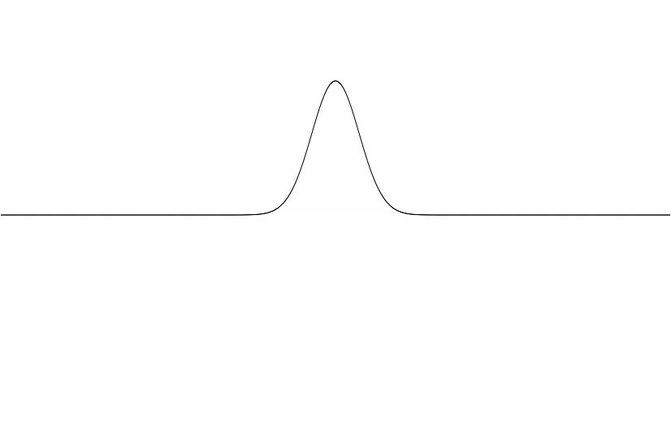
Proof outline
Random probing ➔ noisy leakage
For any x and Noise(.) there exists Noise‘(.) such that Noise(x) = Noise‘(f(x))
First extreme case: “no noise” (p≈1)
Noise(0)
Noise(1)
No way to “simulate” this noise except with random probing where q=1 (i.e., reveals everything).
Notes:
Finite field

Slide 38
Proof outline
Random probing ➔ noisy leakage
For any x and Noise(.) there exists Noise‘(.) such that Noise(x) = Noise‘(f(x))
Second extreme case: “full noise” (p=0)
Noise(0) and Noise(1)
are identical
Set Noise‘ = Noise: Simulation is possible without even probing: q = 0 (i.e., reveals nothing)
Notes:
Finite field

Slide 39
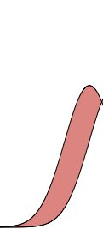
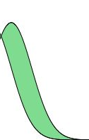

Proof outline
If f(x) =0 ➔ Pr[N(0) =y] –
Pr[N(1)=y] (normalized)
Interesting case: “some noise”
Noise(0)
Noise(1)
If f(x) =1
(similar)
If f(x) = ? ➔ sample y according to
min(Pr[N(0)=y], Pr[N(1)=y]) (normalized)
One can “simulate” Noise(.) with random probing when probability q is exactly Δ(Noise(0),Noise(1))
(proof is essentially a simple „averaging argument“)
Notes:
Finite field

Slide 40
Leakage resilient circuits
Conclusion

Slide 41
Conclusion
Why proofs for masking?
Systematic analysis to avoid flaws
➔ Proofs in n-probing model to check for n-th order flaws
New ideas and schemes
➔ IP masking an alternative for additive masking?
Formal requirements on hardware
➔ How much noise do I need to use masking?
Many open questions
Dependency, glitches,
better bounds...
Better models
O(n) complexity also for small circuits
Better efficiency

Slide 42
Thank you!

